Slide 1
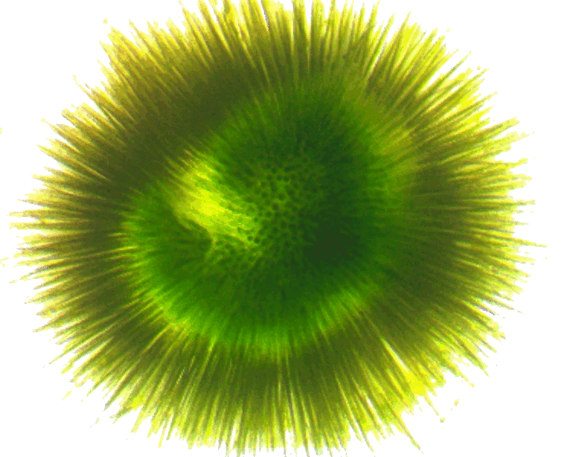
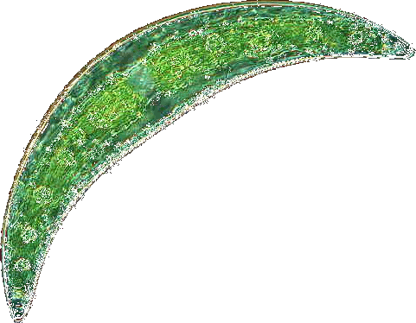


Phytoplankton community composition and cyanotoxin detection among lakes included in the 2007 National Lake Assessment
Betty J. Kreakie¹ , W. Bryan Milstead¹, Jeffrey W. Hollister¹, Elizabeth D. Hilborn¹, & Keith A. Loftin²
Ecological Society of America
August 2017
¹U.S. Environmental Protection Agency
²U.S. Geological Service

Slide 2
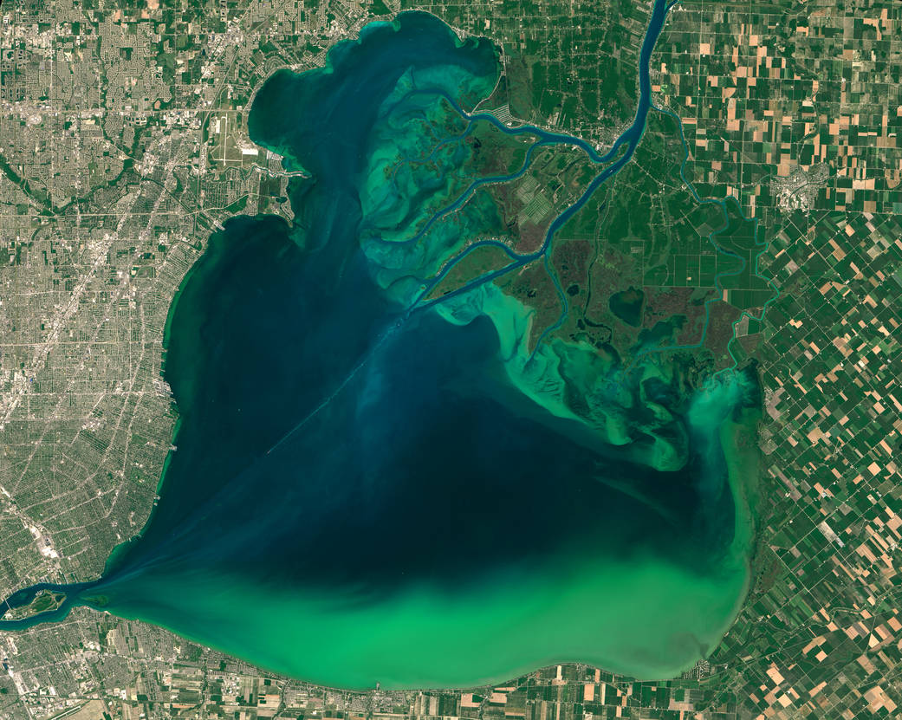
Lake St. Claire
July 28, 2015

Slide 3
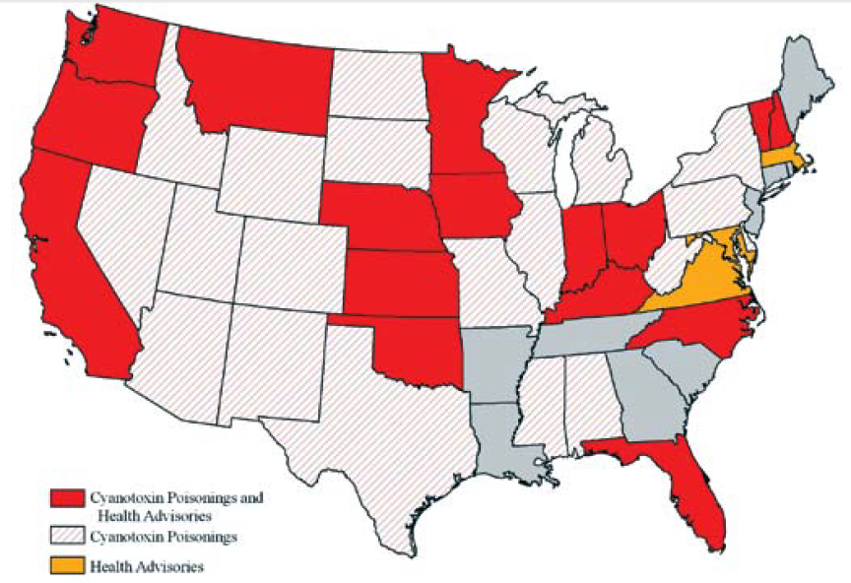
At least 36 States and 50 Countries have reported cyanotoxin poisonings
Graham et al 2009 http://ks.water.usgs.gov/studies/qw/cyanobacteria/LLsummer-graham2.pdf

Slide 4
EPA Health Advisory Concentrations for Microcystins and Cylindrospermopsin
Drinking water health advisory:
Microcystin: 1.6 µg/L adults; 0.3 µg/L preschool children
Cylindrospermopsin: 3 µg/L adults; 0.7 µg/L preschool children
EPA, Office of Water, 820F15003, June 2015
Recreational Ambient Water Swimming Advisories:
Microcystins: 4 µg/L
Cylindrospermopsin: 8 µg/L
“If used as a swimming advisory to protect swimmers at a beach, these values are not to be exceeded on any single day”
EPA, 822-P-16-002, December, 2016

Slide 5
Questions:
Are there identifiable phytoplankton community types across the coterminous United States?
Is cyanotoxin detectability related to phytoplankton community type?
What are the environmental or biotic determinants of community type?

Slide 6
Methods - Data
Data from the 2007 National Lake Assessment.
1148 lakes with complete physical, chemical and biological data selected for analysis.
Genus level phytoplankton abundances analyzed by non-metric multidimensional scaling (NMDS) [R::vegan:: metaMDS; K=4; N=10,000]
Phytoplankton identified to genus and enumerated
Total sample Cyanotoxin (microcystin, saxitoxin, cylindrospermopsin) concentrations measured by ELISA

Slide 7
Methods - Analysis
Genus level phytoplankton abundances analyzed by non-metric multidimensional scaling (NMDS) [R::vegan:: metaMDS; K=4; N=10,000]
Cluster analysis used to define lake groupings
Indicator species analysis with random forest and labdsv::indval

Slide 8
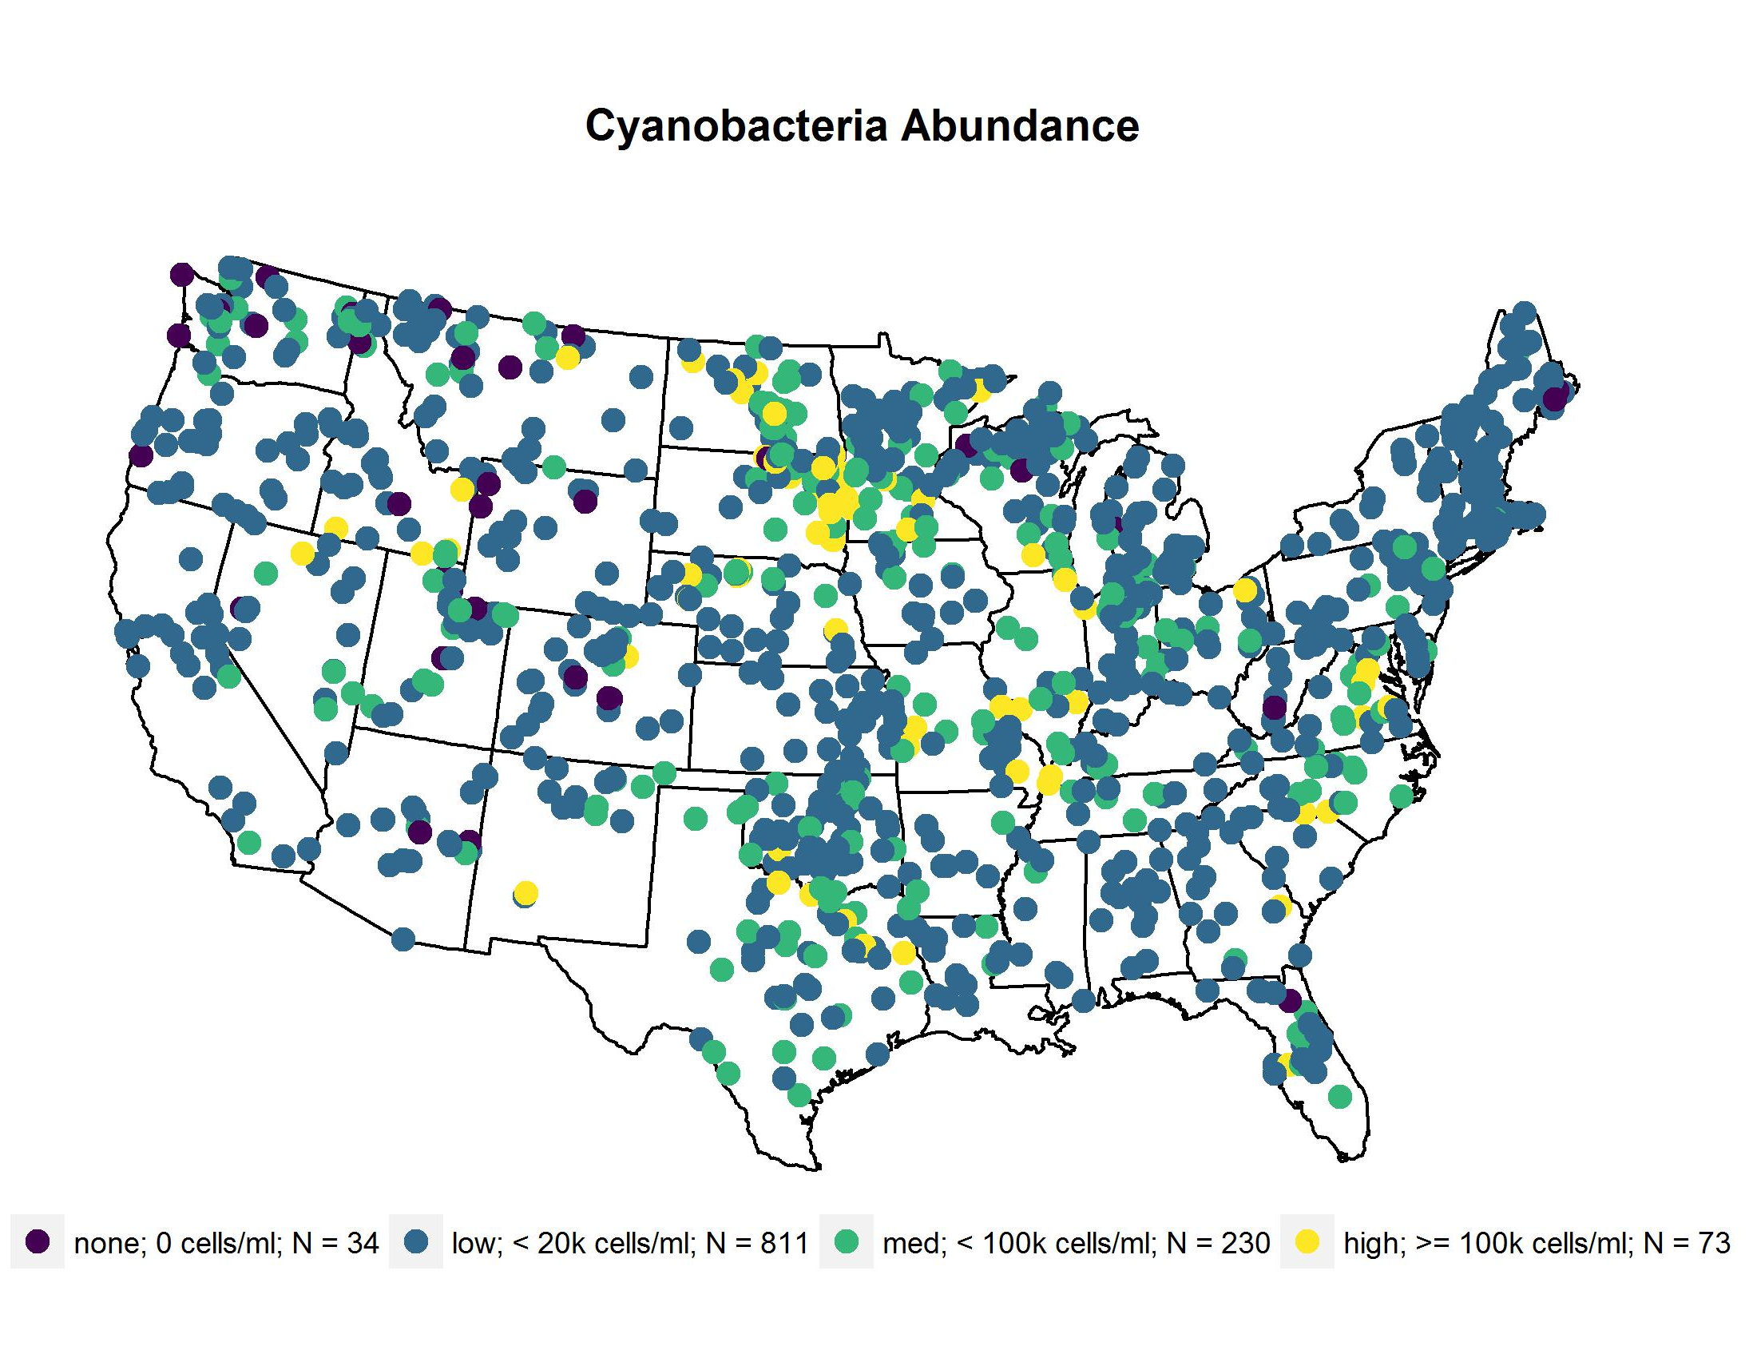
Sample Sites

Slide 9
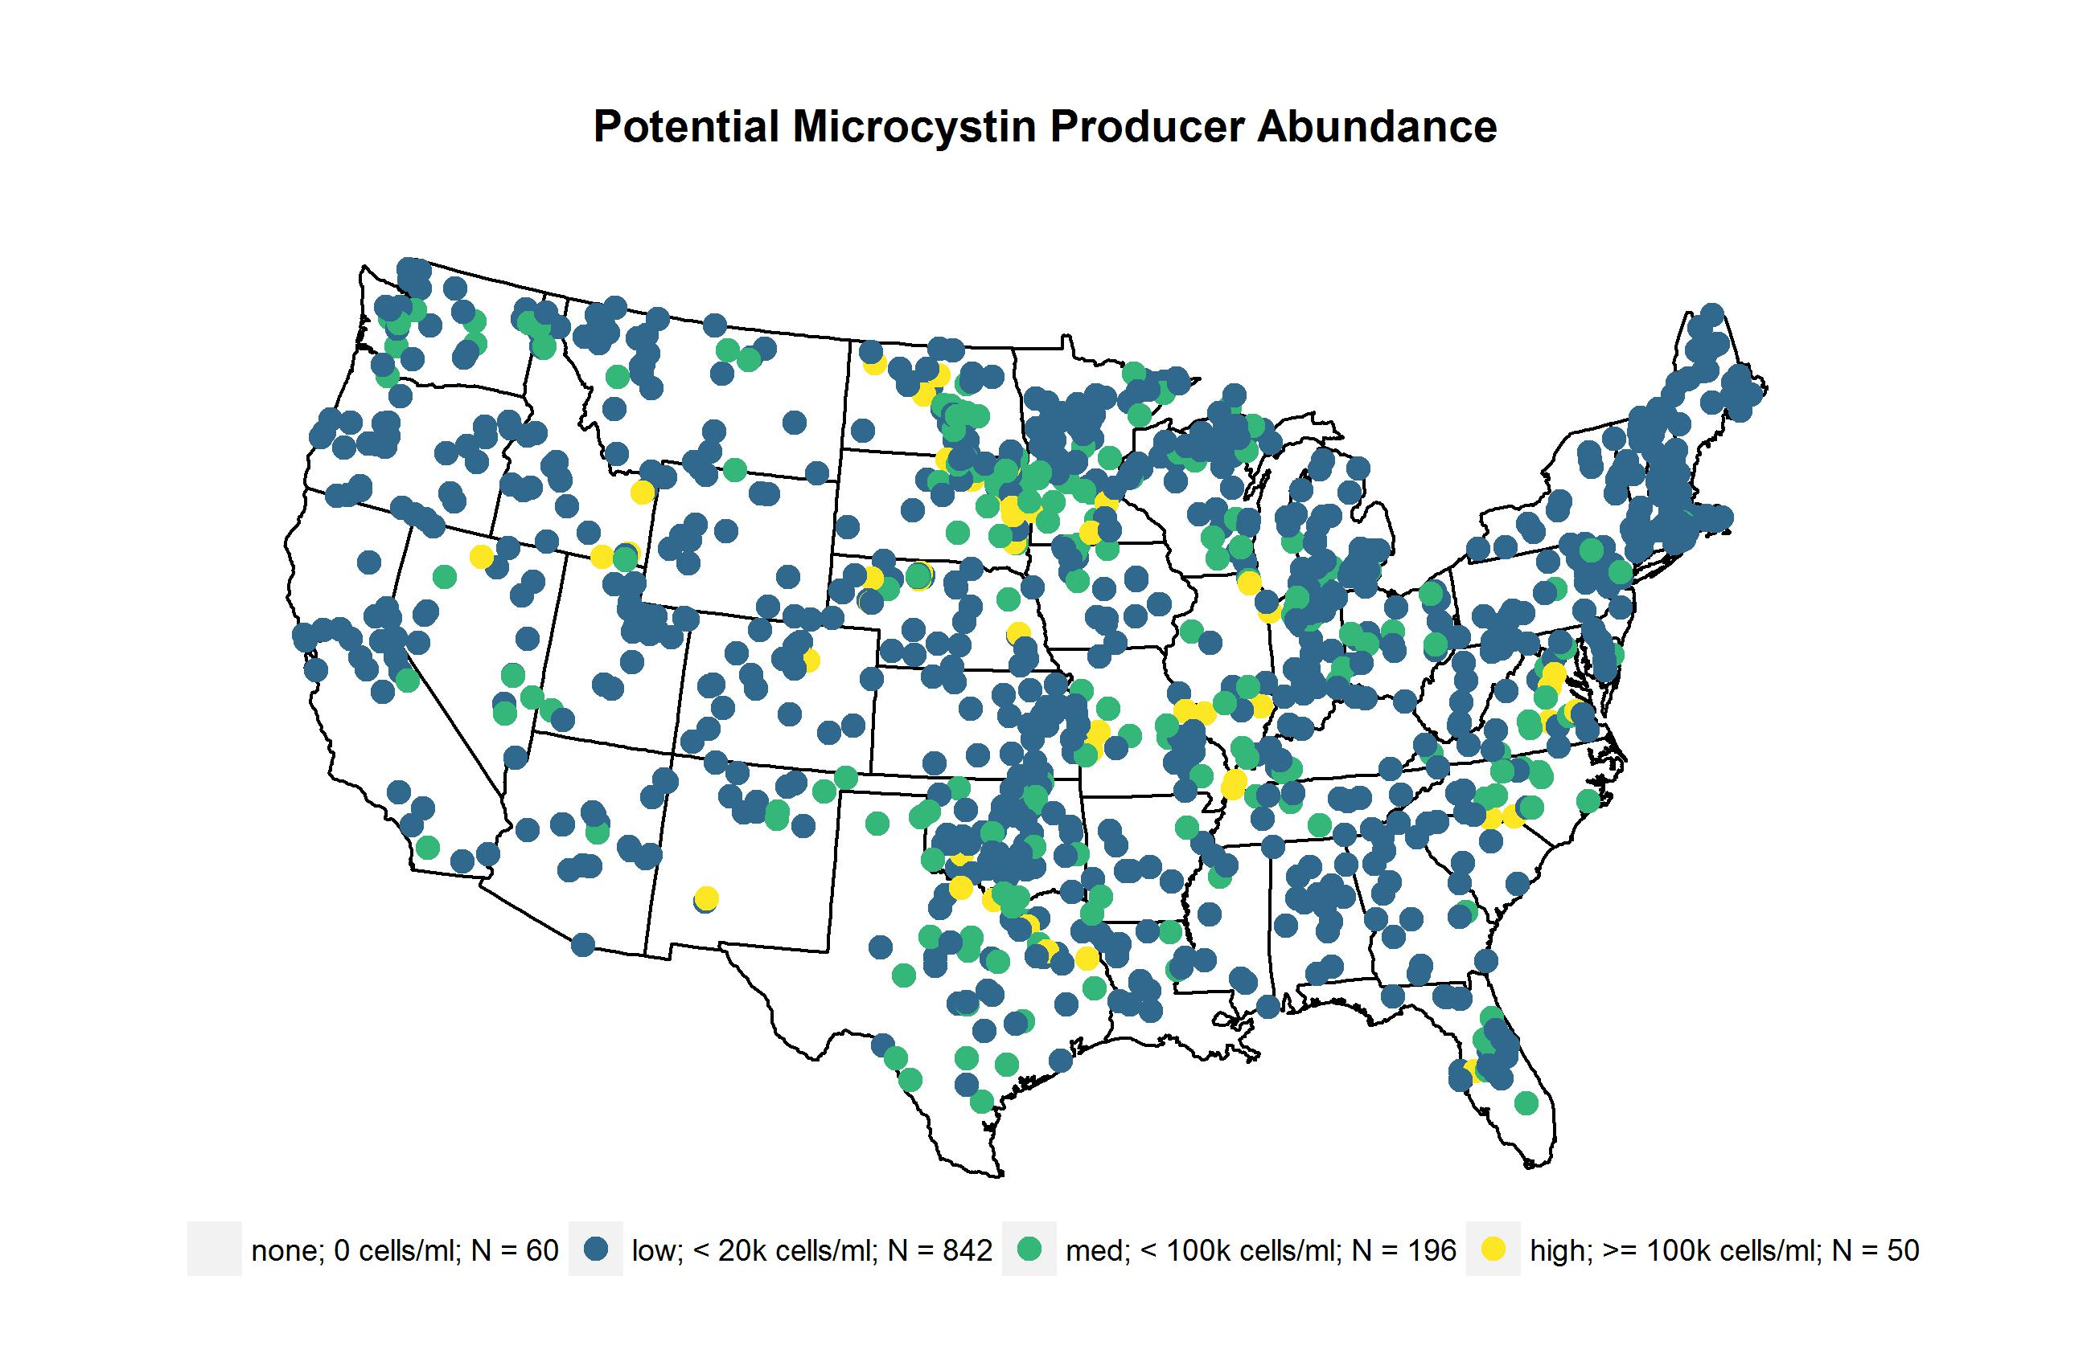
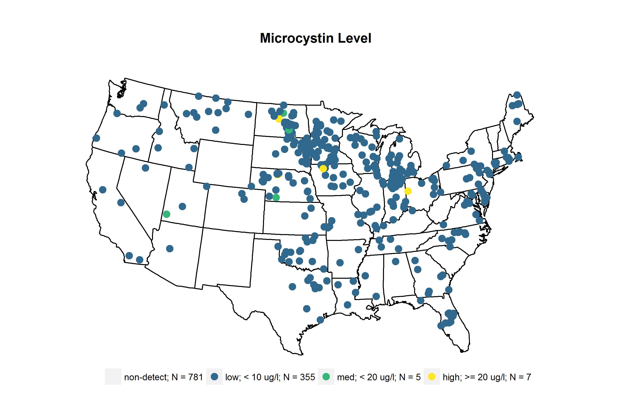
 | Lakes | cells/ml
genus | n | median | mean | max
Anabaena + Dolichospermum | 643 | 312 | 3461 | 13539
Anabaenopsis | 137 | 188 | 1170 | 3536
Aphanocapsa | 397 | 110 | 13406 | 158052
Coelosphaerium | 166 | 891 | 6094 | 36273
Leptolyngbya | 143 | 1062 | 3271 | 8121
Limnothrix | 80 | 676 | 13383 | 51263
Lyngbya | 268 | 174 | 1853 | 5620
Microcystis | 661 | 2953 | 27974 | 204147
 | Lakes | cells/ml
genus | n | median | mean | max
Oscillatoria + Phormidium + Planktothrix | 521 | 239 | 2929 | 14601
Planktolyngbya | 93 | 305 | 1714 | 5530
Pseudanabaena | 106 | 323 | 1802 | 6861
Snowella | 26 | 703 | 2030 | 5357
Synechococcus | 283 | 201 | 407 | 591
Synechocystis | 187 | 490 | 2421 | 8951

Slide 10

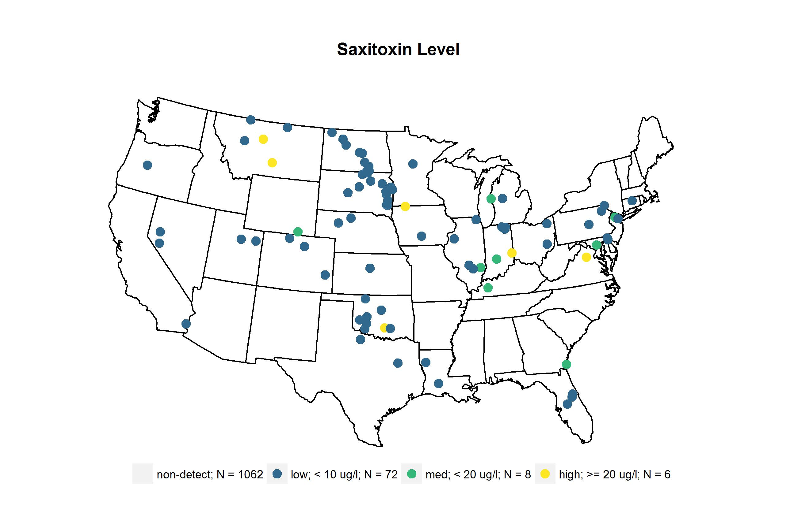
 | Lakes | cells/ml
genus | n | median | mean | max
Anabaena + Dolichospermum | 643 | 312 | 3461 | 13539
Aphanizomenon | 318 | 740 | 8527 | 25923
Cylindrospermopsis | 47 | 438 | 2481 | 5268
Lyngbya | 268 | 174 | 1853 | 5620
Oscillatoria + Phormidium + Planktothrix | 521 | 239 | 2929 | 14601
Planktolyngbya | 93 | 305 | 1714 | 5530

Slide 11

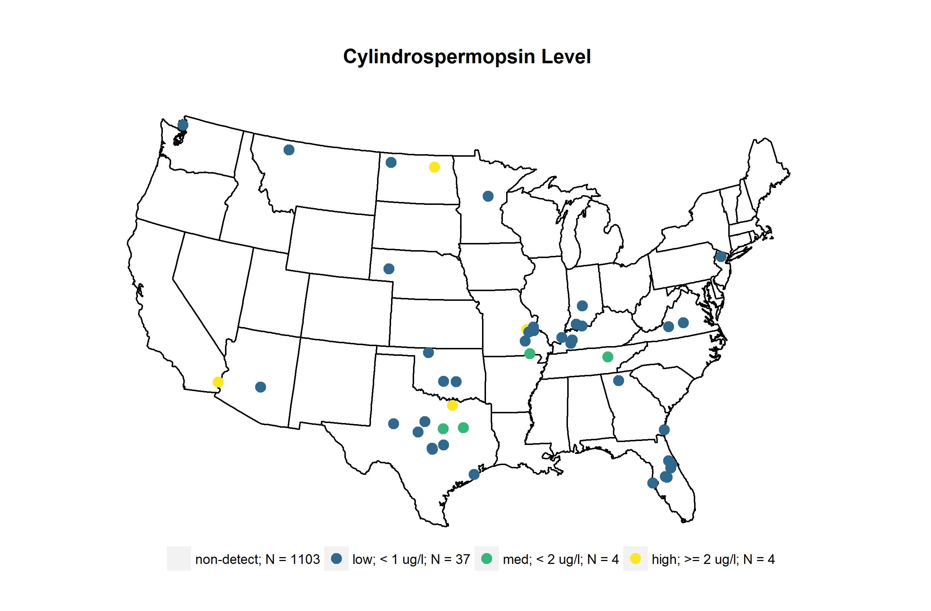
 | Lakes | cells/ml
genus | n | median | mean | max
Anabaena + Dolichospermum | 643 | 312 | 3461 | 13539
Aphanizomenon | 318 | 740 | 8527 | 25923
Cylindrospermopsis | 47 | 438 | 2481 | 5268
Lyngbya | 268 | 174 | 1853 | 5620
Raphidiopsis | 134 | 74 | 1328 | 7030

Slide 12
Table of phyto taxonomy

Slide 13
Question: are there patterns of community type

Slide 14
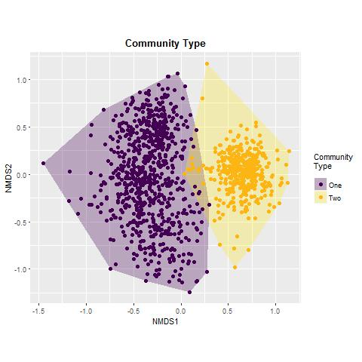
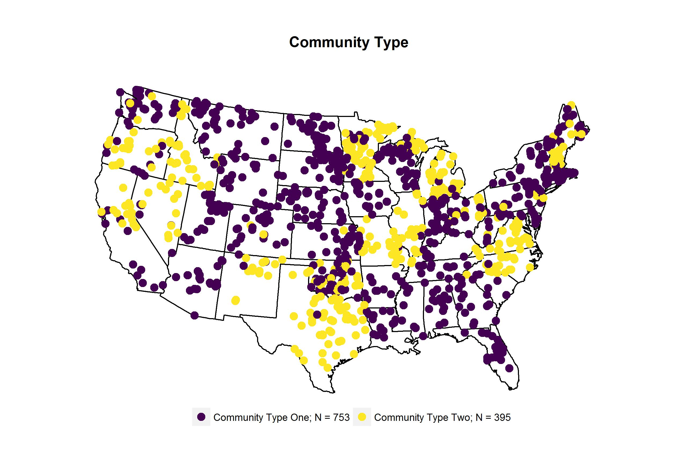
Call:
metaMDS(comm = phyto07[, -1], k = 4, trymax = 10000)
global Multidimensional Scaling using monoMDS
Data: wisconsin(sqrt(phyto07[, -1]))
Distance: bray
Dimensions: 4
Stress: 0.178225
Stress type 1, weak ties
No convergent solutions - best solution after 10000 tries
Scaling: centring, PC rotation, halfchange scaling
Species: expanded scores based on ‘wisconsin(sqrt(phyto07[, -1]))’

Slide 15
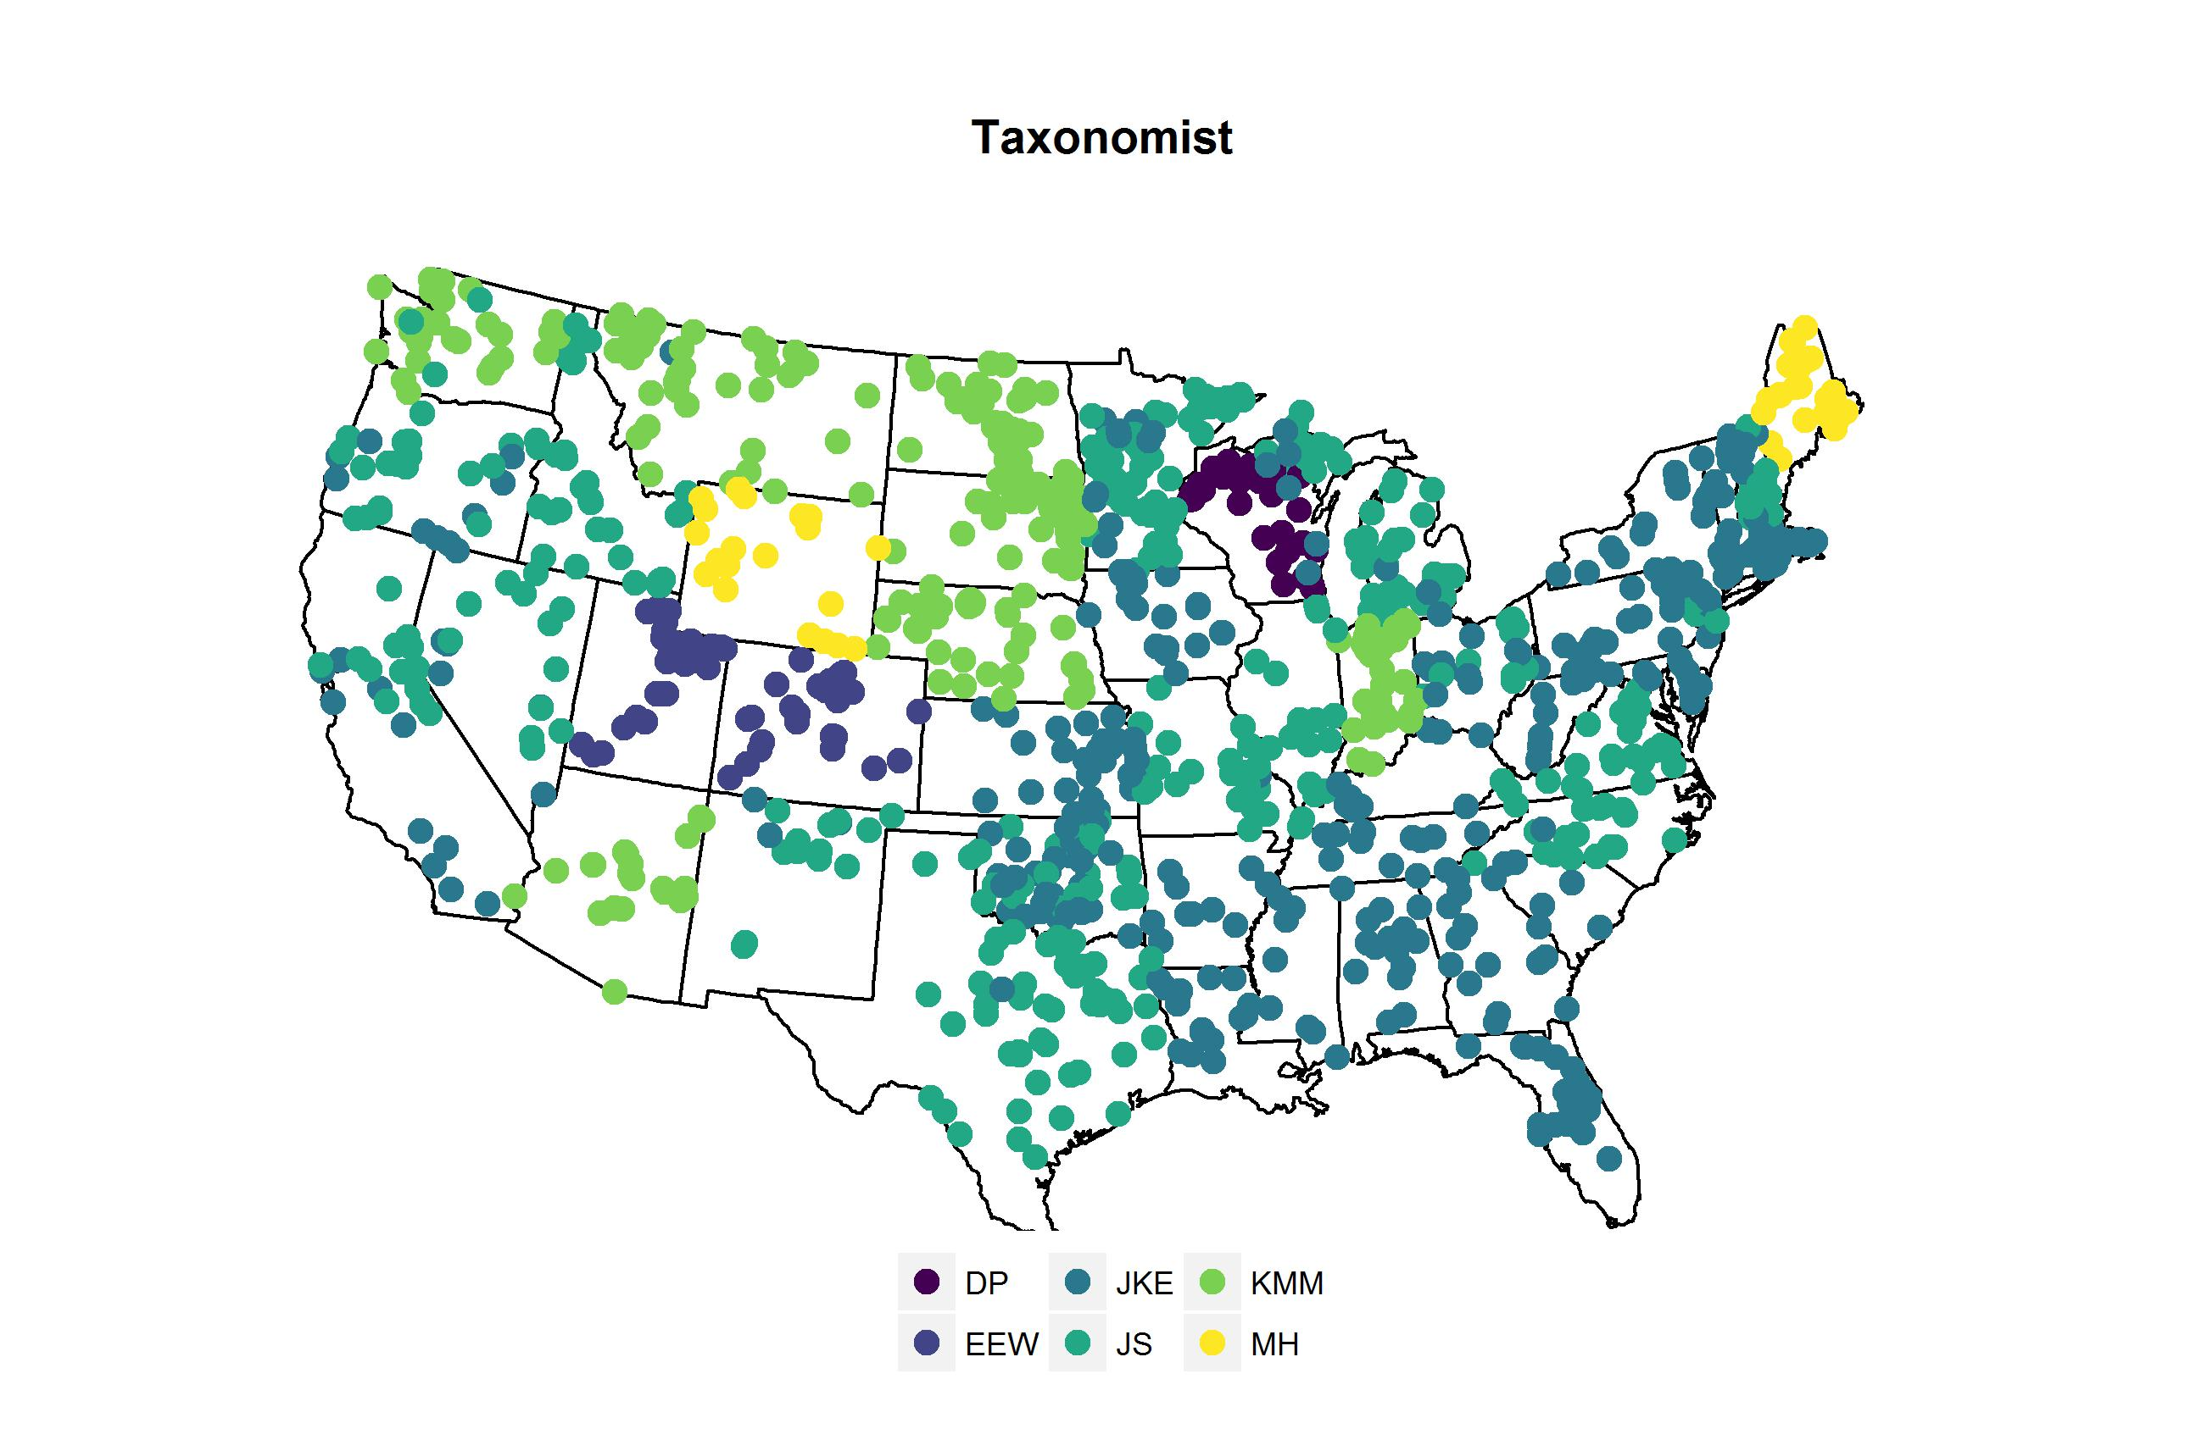

Slide 16
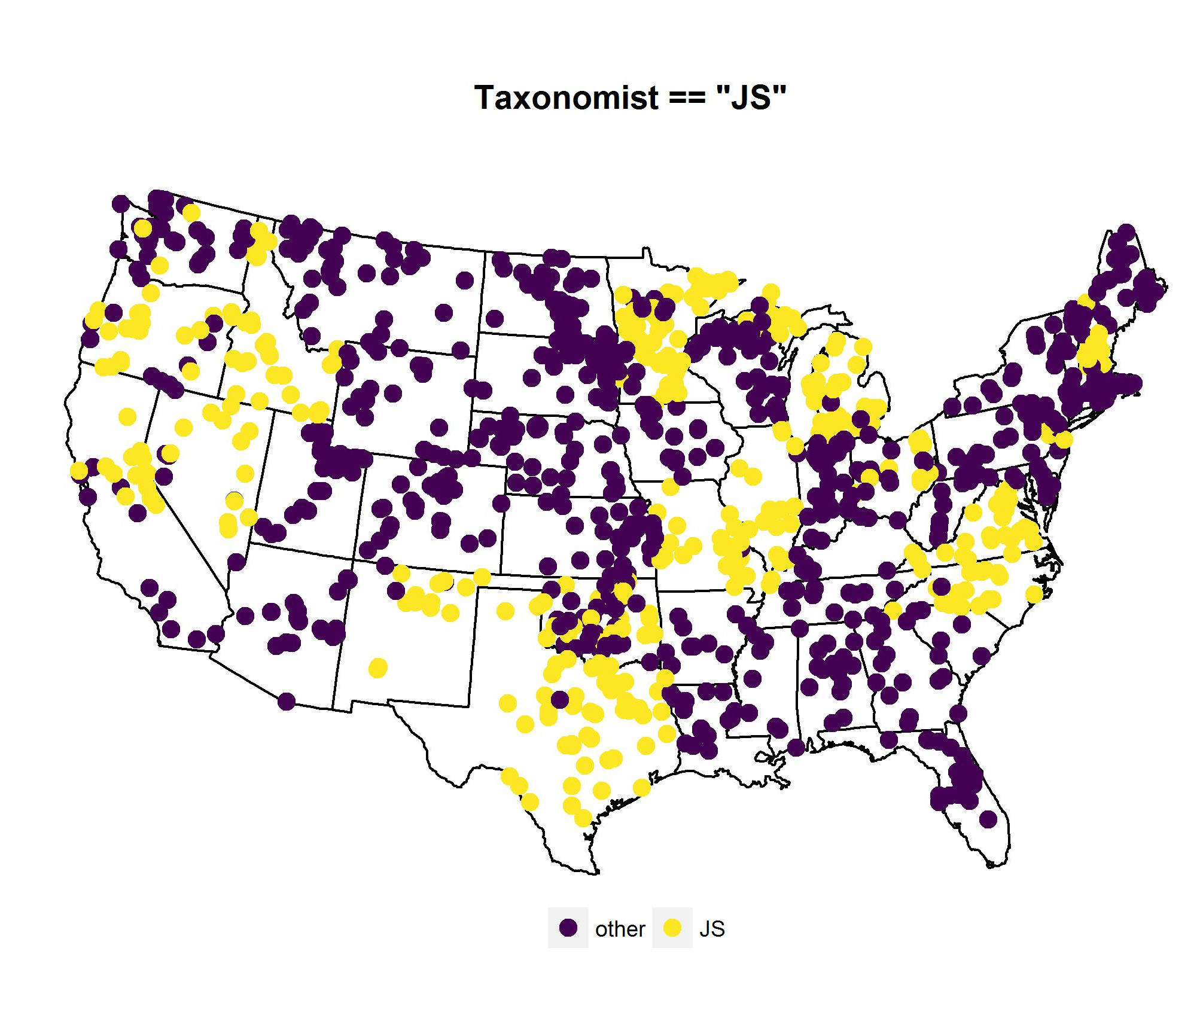

Slide 17
Question: are there patterns of community type
Conclusions:
two distinct community types identified
Possible spatial pattern to community types

Slide 18
Question: relationship btw community type and cyano abund/toxin

Slide 19
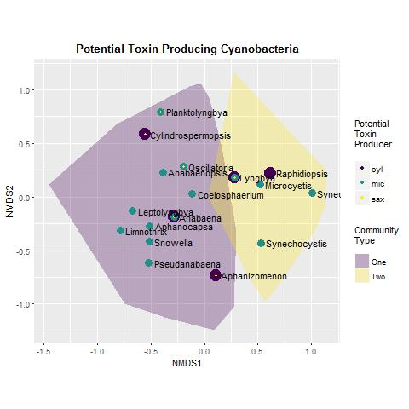
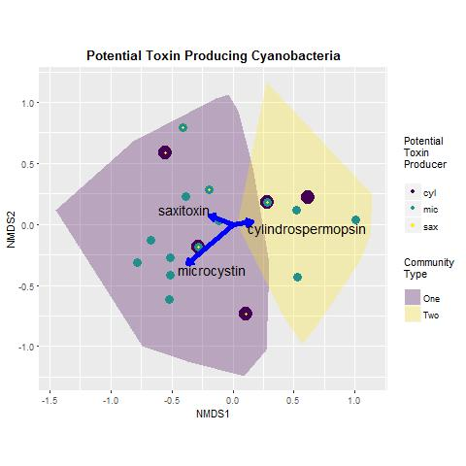

Slide 20
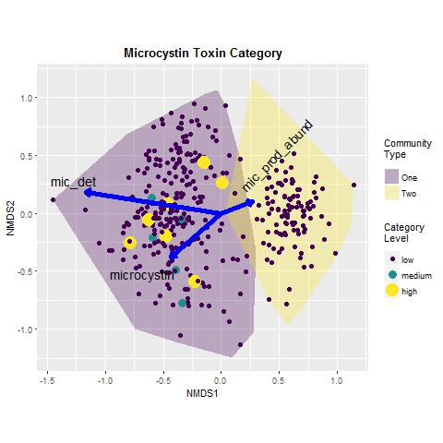
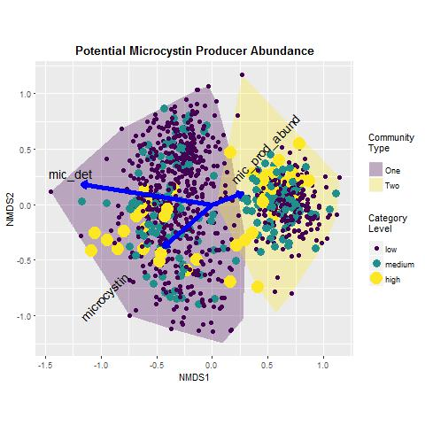

Slide 21
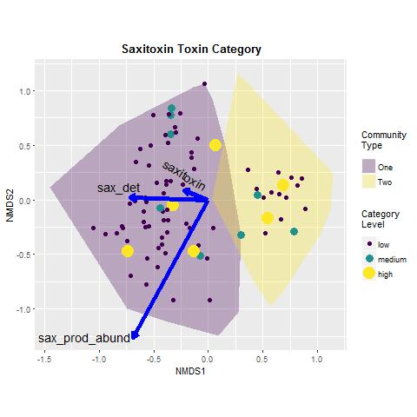
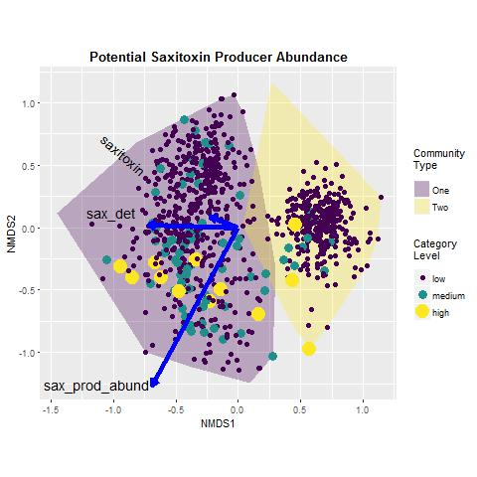

Slide 22
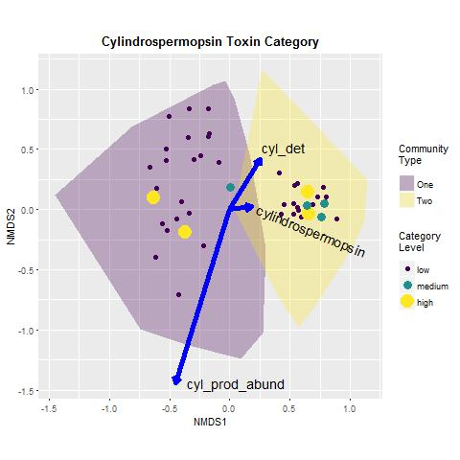
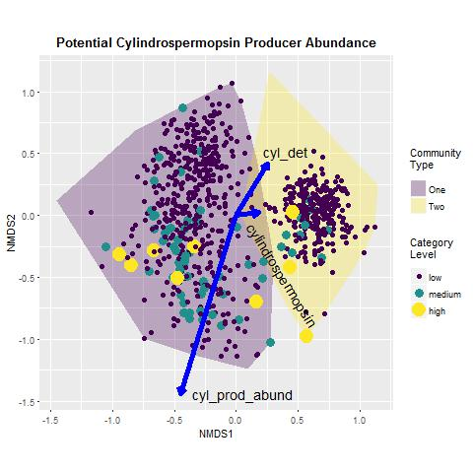

Slide 23
Question: relationship btw community type and cyano abund/toxin
Conclusions:
Clear identification of each toxin with one community type
No relationship between the abundance of potential toxin producing genera and toxin detections or concentrations

Slide 24
Question: What are the environmental or biotic determinants of community type?
Conclusions:
Lake community types are strongly associated with eutrophication indicators
Each lake community type has distinct indicator species; at this point we cannot interpret the results because we have not idea what we are doing as phycologists

Slide 25
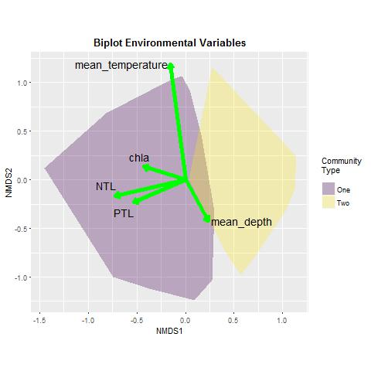

Slide 26
Conclusions:
From the three previous conclusion slides

Slide 27
Next Steps:
Investigate characteristics of indicator species
Develop predictions and test with the 2012 NLA data

Slide 28

Thank You
Bryan Milstead
U.S. Environmental Protection Agency
Narragansett RI
milstead.bryan@epa.gov
401-782-3015
August 2014

